Slide 1
COMP1860: Building Our Digital World Computer Systems & Architecture
S1.W5.L2 Hardware Description Language
& Computer Aided Design LAB 2

Slide 2
Learning Outcomes
Analyse and design a combinational logic circuit
Utilize a hardware simulator to design, test, and analyze the behavior of a digital circuit
Implement and debug combinational logic circuits using HDL

Slide 3
Text Book
  Nand2Tetris HDL Guide / Documentation:
  The Elements of Computing Systems / Appendix 2: HDL

Slide 4
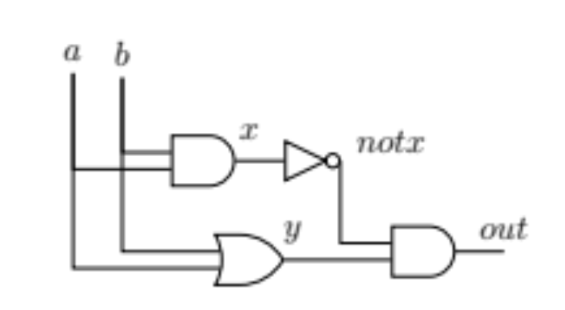
Hardware Description Language
/**
* Xor gate.
*/
CHIP Xor {
IN a, b;
OUT out;
PARTS:
And (a=a, b=b, out=x);
Or (a=a, b=b, out=y);
Not (in=x, out=notx);
And (a=y, b=notx, out=out);
}
Header
Parts
  Nand2Tetris HDL Guide / Documentation:
  The Elements of Computing Systems / Appendix 2: HDL

Slide 5
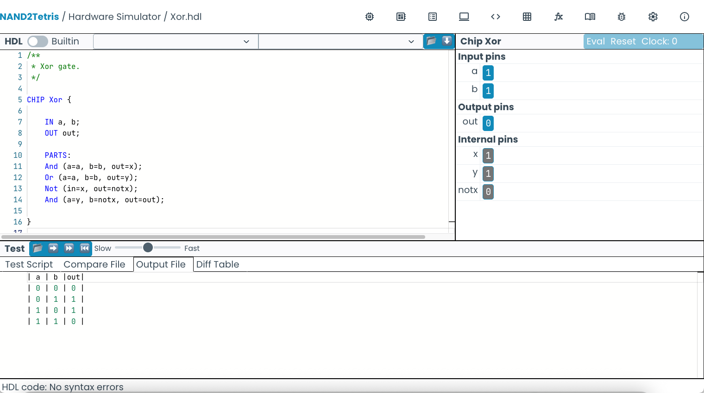
Introduced the Hardware Simulator
Simulate HDL chips
Automated test scripts
https://nand2tetris.github.io/web-ide/chip/

Slide 6
Overview
Look at Solution for final problem from lab 1.5.1
Learn how to implement buses in HDL
Build some more of the chips for our Hack computer
Opportunity to start work on Activity sheet 1.6

Slide 7
From last time
Two binary numbers, a and b, each of two digits, are represented as a₁a­₀ and b₁b₀ where a₁, a₀ and b₁, b₀ are Boolean variables which form the digits of the binary numbers.
Devise a combinatorial logic circuit, or circuits to provide outputs of X,Y, Z such that X=1 when a>b, Y=1 when a<b and Z=1 when a=b.
Implement the circuits in HDL. Create an appropriate test script and compare file to test your solution.

Slide 8






a1a0 | b1b0 | x
00 | 00 | 0
00 | 01 | 0
00 | 10 | 0
00 | 11 | 0
01 | 00 | 1
01 | 01 | 0
01 | 10 | 0
01 | 11 | 0
10 | 00 | 1
10 | 01 | 1
10 | 10 | 0
10 | 11 | 0
11 | 00 | 1
11 | 01 | 1
11 | 10 | 1
11 | 11 | 0
 |  | a1a0
 |  | 00 | 01 | 11 | 10
b1b0 | 00 | 0 | 1 | 1 | 1
 | 01 | 0 | 0 | 1 | 1
 | 11 | 0 | 0 | 0 | 0
 | 10 | 0 | 0 | 1 | 0
$$⋁$$
$$a0 ⋀¬b0⋀¬b1$$
$$⋁$$
$$¬b0 ⋀a0 ⋀a1$$
$$a1 ⋀¬b1$$

Slide 9
Multi-bit bus
In HDL sometimes we wish to manipulate a sequence of bits as a single entity
将一系列位作为一个整体来操作
In Nand2Tetris such a multi-bit entity is termed “bus”
Example: 16-bit bus
16-bit bus：
把16个1bit的 输入/输出信号并联在一起，每1bit对应一个输入/输出信号
d c b a
15
14
13
12
11
10
9
8
7
6
5
4
3
2
1
0
1
0
0
0
1
0
0
0
1
1
0
1
1
1
0
1
MSB = Most significant bit
LSB = Least significant bit

Slide 10
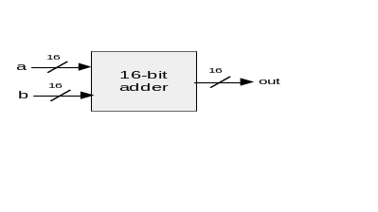
Working with buses: Example
/* Adds two 16-bit values. */
CHIP Adder {
IN a[16], b[16];
OUT out[16];
PARTS:
...
}
[16] 代表16-bits bus
/* Adds three 16-bit inputs. */
CHIP Adder3Way {
IN a[16], b[16], c[16];
OUT out[16];
15
. . .
1
0
a:
1
. . .
1
1
b:
0
. . .
1
0
c:
0
. . .
0
1
out:
1
. . .
1
0

Slide 11
Working with buses: Example
/* Adds two 16-bit values. */
CHIP Adder {
IN a[16], b[16];
OUT out[16];
PARTS:
...
}
/* Adds three 16-bit inputs. */
CHIP Adder3Way {
IN a[16], b[16], c[16];
OUT out[16];
PARTS:
Adder(a=a , b=b, out=ab);
Adder(a=ab, b=c, out=out);
}
定义3个16-bits bus输入a, b, c；和1个16-bits输出out
15
. . .
1
0
n-bit value (bus) can be treated as a single entity
a:
1
. . .
1
1
b:
0
. . .
1
0
c:
0
. . .
0
1
Creates an internal bus pin (ab)
out:
1
. . .
1
0
16-bits数 a + b + c = out: a + b->ab ; ab + c -> out

Slide 12
Working with individual bits within buses
/* Returns 1 if a==1 and b==1,
* 0 otherwise. */
CHIP And {
IN a, b;
OUT out;
...
}
回到题目，我们用a0a1和b0b1比较，输入用到了4个1bits信号，所以用一个16-bits的bus中的4bits就够了: a[4]
/* 4-way And: Ands 4 bits. */
CHIP And4Way {
IN a[4];
OUT out;
PARTS:
And(a=a[0], b=a[1], out=and01);
And(a=and01, b=a[2], out=and012);
And(a=and012, b=a[3], out=out);
}
Input bus pins can be subscripted.
3
2
1
0
a:
0
1
1
1
但是 and gate只要1-bit信号作为输入，
所以传入时，需要指定用4-bits信号中的哪一位作为输入，所以用下标指定（和数组一样a[1]）
out:
0

Slide 13
Working with individual bits within buses
/* Returns 1 if a==1 and b==1,
* 0 otherwise. */
CHIP And {
IN a, b;
OUT out;
...
}
/* 4-way And: Ands 4 bits. */
CHIP And4Way {
IN a[4];
OUT out;
PARTS:
And(a=a[0], b=a[1], out=and01);
And(a=and01, b=a[2], out=and012);
And(a=and012, b=a[3], out=out);
}
and01 = a[0] and a[1]
and02 = and01 and a[2]
out = and01 and and2
and01/02是芯片内引脚pin
out是芯片外引脚pin（1-bit）
Input bus pins can be subscripted.
3
2
1
0
a:
0
1
1
1
out:
0
3
2
1
0
/* Bit-wise And of two 4-bit inputs */
CHIP And4 {
IN a[4], b[4];
OUT out[4];
PARTS:
And(a=a[0], b=b[0], out=out[0]);
And(a=a[1], b=b[1], out=out[1]);
And(a=a[2], b=b[2], out=out[2]);
And(a=a[3], b=b[3], out=out[3]);
}
out[0] = a[0] and b[0]
out[1] = a[1] and b[1]
out[2] = a[2] and b[2]
out[3] = a[3] and b[3]
out1-4是芯片外16-bits引脚pin的低4位
a:
0
1
0
1
Output bus pins can be subscripted
b:
0
0
1
1
out:
0
0
0
1

Slide 14
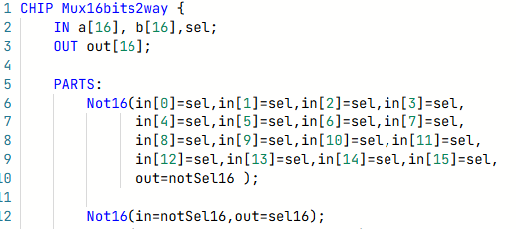
将1-bit信号扩展到16-bits bus

Slide 15
信号切片
您还可以使用总线中的一系列位，而不是整个总线。
例如，如果您只想使用And16门输出中的4个最低有效位，或者只想使用16位计数器或寄存器的8位。
Outputs the whole 16 bit bus
CHIP MyChip {
IN a[16], b[16];
OUT out[16];
PARTS:
And16(a=a, b=b, out=out, out[0..3]=lsb);
And4Way(a=lsb, out=4wayout);
}
Outputs only bus pins 0 to 7 as an internal bus called lsb of width 4.

Slide 16
信号切片
You can manually set pins, buses or parts of buses to high (true) or low (false) values. This can be useful for masking bits.
You can also connect different sources to different parts of a bus.
Sets all 16 bits of input b to true.
CHIP MyChip {
IN input1[16], input2[16];
OUT output[16];
PARTS:
And16(a=input1, b=true, out=output);
And16(a[0..7]=false, a[8..15]=input1[8..15], out=output);
}
将a的8个最低有效位设置为false，将输入1的8个最高有效位设置成最高有效位。

Slide 17
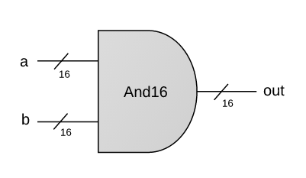
Your Turn: And16
Example:
a = 1 0 1 0 1 0 1 1 0 1 0 1 1 1 0 0
b = 0 0 1 0 1 1 0 1 0 0 1 0 1 0 1 0
out = 0 0 1 0 1 0 0 1 0 0 0 0 1 0 0 0
CHIP And16 {
IN a[16], b[16];
OUT out[16];
PARTS:
// Put your code here:
}
Implementation tip
A straightforward 16-bit extension of the elementary And gate
(See notes about working with multi-bit buses).

Slide 18
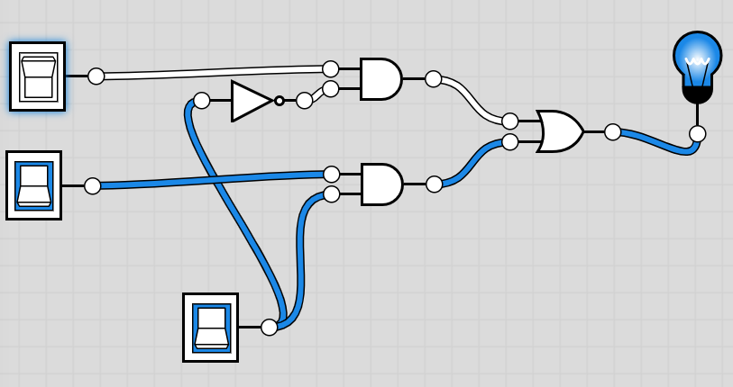
Your turn: Implement a 2-Way 1-bit multiplexer (MUX)
Your saw Multiplexers in lecture 1.4.1
A multiplexer is a selector
One of the inputs will be output
Which one depends on the selection input (sel)
The preamble for the chip is:
a
Mux
out
sel | out
0 | a
1 | b
b
sel
Mux.hdl
CHIP Mux {
IN a, b, sel;
OUT out;
PARTS:
// Put your code here:
}

Slide 19
Your turn: Implement a 2-Way 16-bit multiplexer
In our computer we are likely to want to select between 16-values rather than 1-bit values.
Create a new chip Mux16 that selects between 16-bit input values and outputs a 16-bit output.
The Nand2Tetris built in chips provides the following chips that you might find helpful:
Not16(in,out) a 16-bit wide Not gate.
Or16(a,b,out) a 16-bit wide Or Gate.
Mux16.hdl
CHIP Mux16 {
IN a[16], b[16], sel;
OUT out[16];
PARTS:
// Put your code here:
}

Slide 20
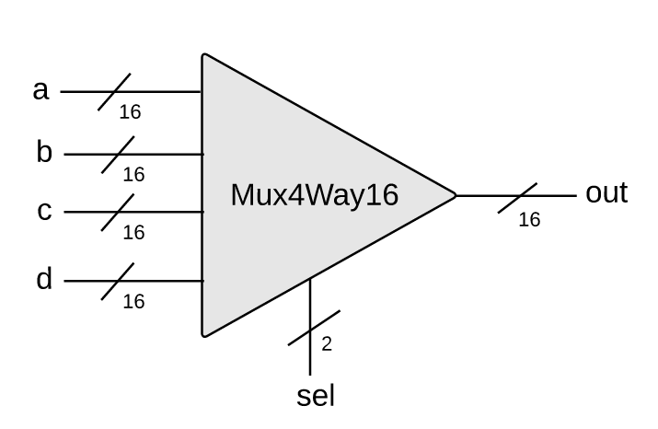
Your turn: Implement a 16-bit, 4-way multiplexer
As you saw in lecture 1.4.1 you can also build multiplexers that select between more than 2 inputs.
On the right is an example of a 4-way (4-to-1) Multiplexer.
sel[1] | sel[0] | out
0 | 0 | a
0 | 1 | b
1 | 0 | c
1 | 1 | d
Mux4Way16.hdl
CHIP Mux4Way16 {
IN a[16], b[16], c[16], d[16],
sel[2];
OUT out[16];
PARTS:
// Put your code here:
}
Implementation tip:
We can use a 2-bit bus for the selection bits to provide 4 possible values for sel..
The chip can be built from several Mux16 gates.

Slide 21
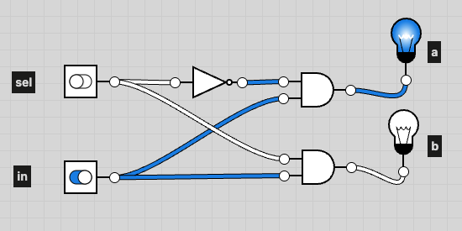
Your turn: Implement a 2-way demultiplexer (DMUX)
As you saw in lecture 1.4.1 Demultiplexers work the other way. They select the output path
The sel input determines which output line (a or b) the input (in) is sent to.
sel | Use output
0 | a
1 | b
a
in
b
sel
DMux.hdl
CHIP DMux {
IN in, sel;
OUT a, b;
PARTS:
// Put your code here:
}

Slide 22
Your turn: A 4-way demultiplexer
We can expand this to have as many outputs as we wish.
We can use a bus for the selection bits to provide all possible values for sel.
a
b
in
c
sel[1] | sel[0] | out
0 | 0 | a
0 | 1 | b
1 | 0 | c
1 | 1 | d
d
sel
DMux4Way.hdl
CHIP DMux4Way {
IN in, sel[2];
OUT a, b, c, d;
PARTS:
// Put your code here:
}
Implementation tip:
The chip can be built from several DMux gates.

Slide 23

Your turn
Now have a go at Activity Sheet 1.5
  Request the activity sheet using the link in Minerva (question 2 is part of your portfolio)
  You should upload the tst files obtained from the activity sheet to your repository to help you test your solutions to question 2.
  Once you have a working solution for question 2, submit your solution to Gradescope to see if it passes all the tests. You can do this by uploading your A6Q2.hdl file.

Slide 24

Your turn:
If you wish to finish building some other gates we will use then complete the list below
Given: Nand
Goal: Build the following gates:
Elementary logic gates
16-bit
variants
Multi-way
variants
Not
And
Or
Xor
Mux
DMux
Not16
And16
Or16
Mux16
Or8Way
Mux4Way16
Mux8Way16
DMux4Way
DMux8Way

Slide 25
Summary
Learnt how to implement buses in HDL
Started to build the chips we will need for our Hack computer
And16
Mux
                Mux16
                Mux4Way16

